Slide 1
Week 3 — Progress Report
Persistent Homology regularization for SmolVLA on LIBERO
Ayush Shah

Slide 2
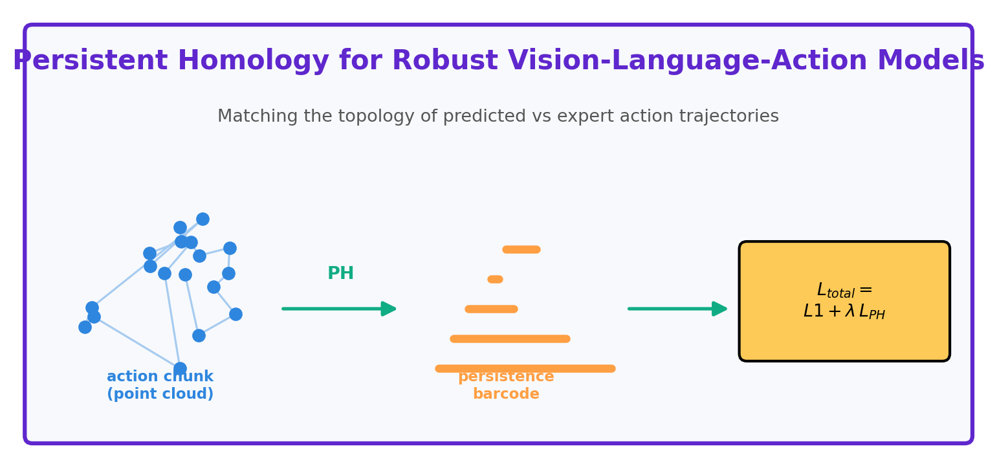
Concept — Persistent Homology (PH)

Slide 3
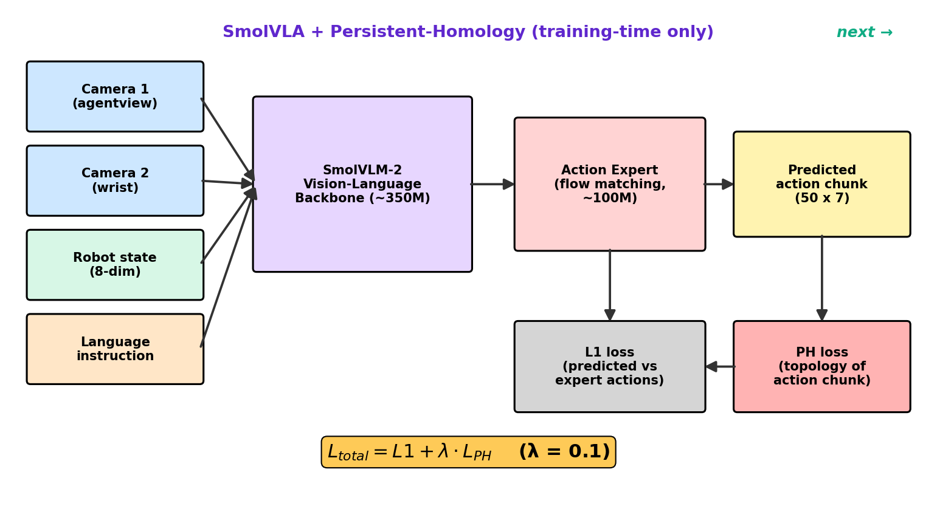
Architecture — SmolVLA + PH
Final loss: L_total = L1 + λ · PH (PH is training-time only)

Slide 4
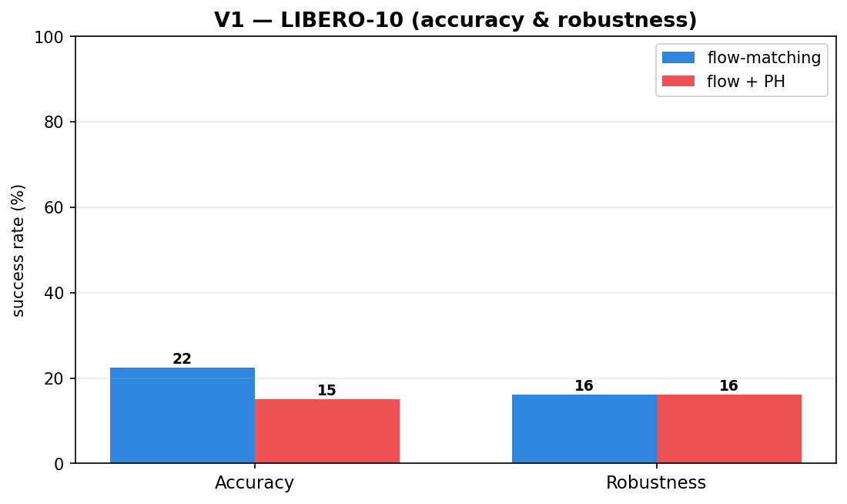
V1 — first run (LIBERO-10)
1.6 epochs • 162 min total (2.7 h)
Parameters & inference latency stay identical (PH is train-only)

Slide 5
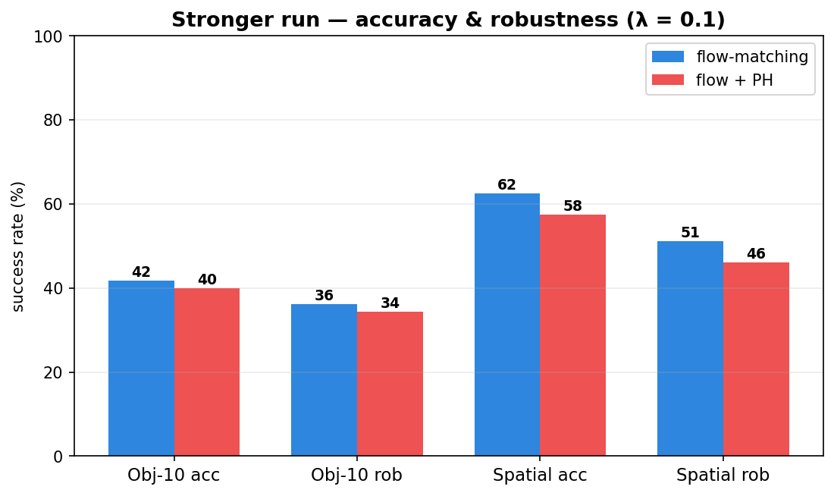
Stronger run — results (λ = 0.1)
6.8 epochs • 553 min total (9.2 h)
Parameters & latency unchanged • LIBERO-10 + LIBERO-Spatial

Slide 6
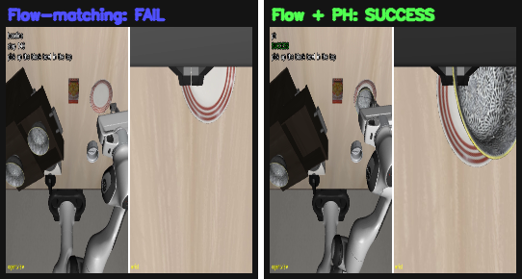
Stronger run — PH succeeds where flow-matching fails
LIBERO-Spatial task 4 — Left: flow-matching (FAIL) | Right: flow + PH (SUCCESS)

Slide 7
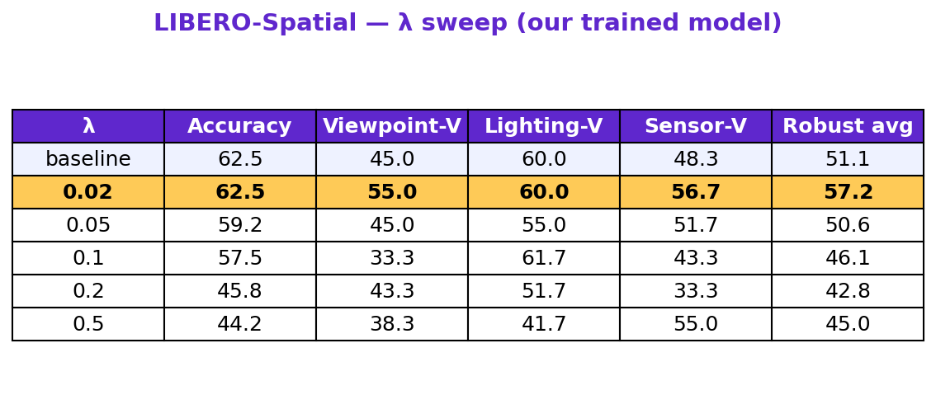
Results not as required → sweep λ (our trained model)
7.6 epochs • 872 min total (14.5 h)
Best λ highlighted = 0.02 • robustness on viewpoint / lighting / sensor-noise

Slide 8
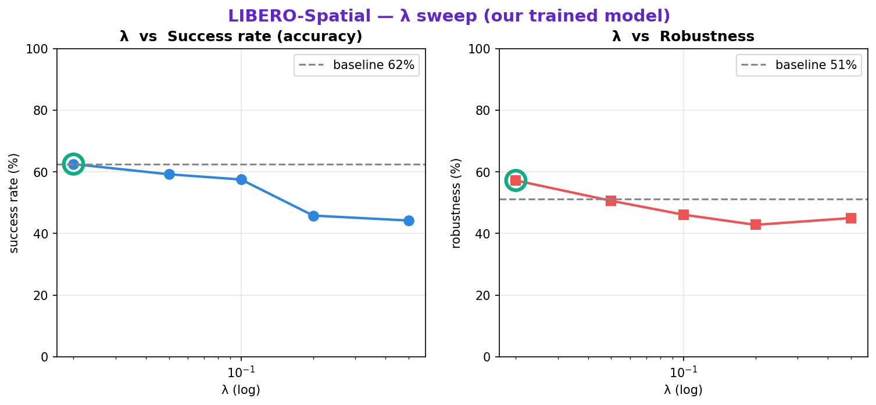
λ sweep — success vs robustness (our trained model)
green ring = best λ (0.02)

Slide 9
Using an official online checkpoint
• We could not reach SmolVLA's maximum capacity on LIBERO with our own training.
• So we used an official online checkpoint (lerobot/smolvla_libero) that claims higher accuracy.
• We recreated the model from that checkpoint…
• …and fine-tuned it with PH for different values of λ.

Slide 10
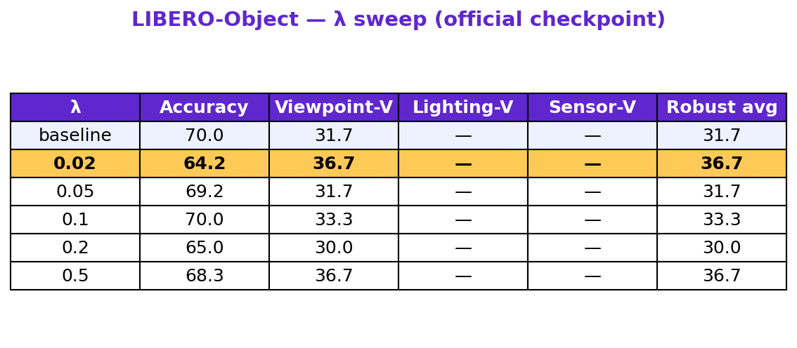
Official checkpoint — λ sweep table (LIBERO-Object)
2.4 epochs • 517 min total (8.6 h)
Best λ highlighted = 0.02

Slide 11
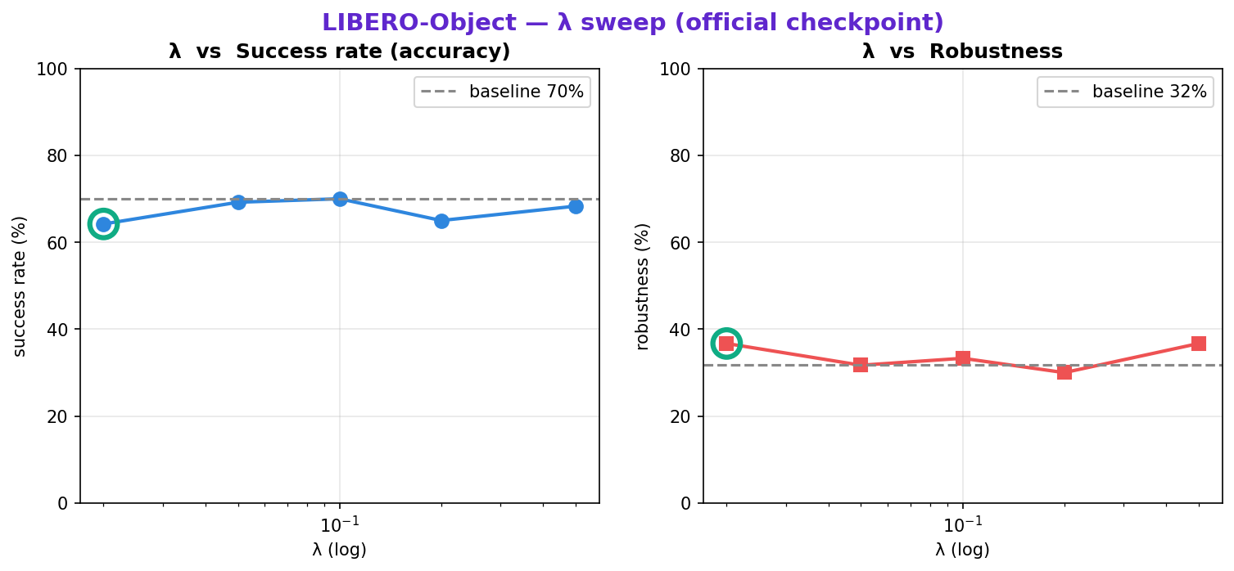
Official checkpoint — success vs robustness
green ring = best λ (0.02)

Slide 12
Thank You
Ayush Shah

